Slide 1
Risk Assessment - In a World Driven by Pushing the Limits, How Can We Possibly Plan for All the Errors?
Dave Winter, CSULB
ENGR 350 -- Fall, 2019

Slide 2
3 Types of Errors and Failures
Problems for Individuals
Safety-Critical Failures
System Failures

Slide 3

Problems for Individuals…

Slide 4
Problems for Individuals
Errors that inconvenience individuals or groups of individuals
Generally, these are the least severe types of errors, though they can have lasting effects:
People who receive false bills online
Those who have incorrect data collected and stored in a database, sometimes without their knowledge
Those who have inherited a false sense of reality, based on their online habits

Slide 5
Problems for Individuals…
Many Problems for Individuals can cause major damages - and often violate Normative Privacy or Positive Rights
Social media platforms that don’t allow people to control their own data
Swatting… ‘nuff said!
Data mishaps (data that is wrongly merged or associated with unrelated data)

Slide 6
Problems for Individuals…
It is virtually impossible to produce a major program or system with absolutely no Problems for Individuals
So… how do we minimize this risk?

Slide 7
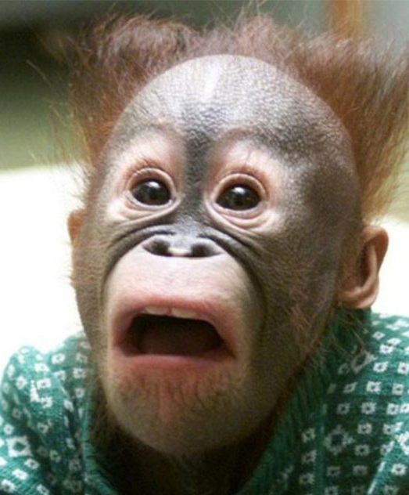
System Failures…

Slide 8
System Failures
Errors that cause either partial or complete failures and can’t really be fixed
Some system failures stem simply from a lack of testing a system before implementation
$325 million Mars Climate Orbiter (1999) disappeared when it should have gone into orbit around Mars – Metric/International vs Imperial/US units
In April 2014, hundreds of LAX flights were cancelled due to a computer bug that crashed all air-traffic monitoring systems

Slide 9
System Failures…
Some system errors happen simply because of increased user load without testing
American Express lost its credit card verification system during the holiday season in 2010 and MasterCard in 2013 – all the security calls for verification overwhelmed the system
Skype went offline for 2 days in 2007 – many users rebooted their systems at the same time after an automatic Microsoft Windows update was pushed

Slide 10
System Failures…
It is estimated that between 15% and 25% of cybertechnology projects are completely abandoned either just before delivery or soon after launch
Why?:
Lack of clear, defined goals and how to accomplish them
Poor communication and management between groups
Use of untested technology with unknown reliability
Scope-creep after work begins
Overconfidence in the technology itself

Slide 11
System Failures…
So… how do we minimize this risk?

Slide 12
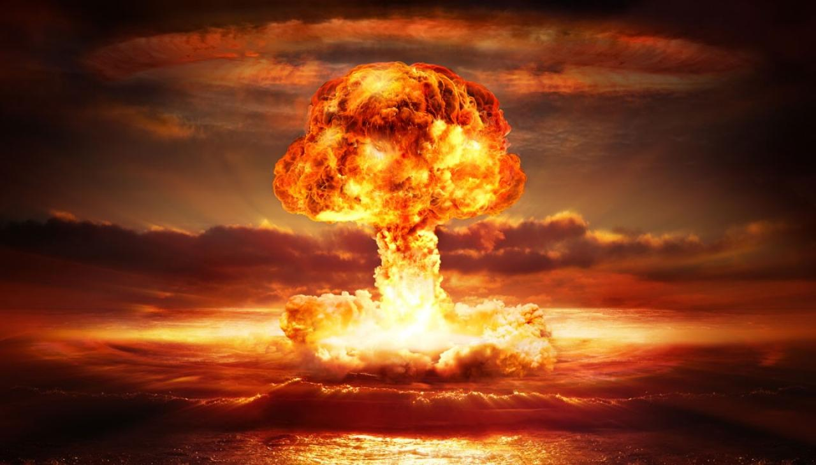
Safety-Critical Failures…

Slide 13
Safety-Critical Failures
Errors that have the potential to injure or kill people
Usually, safety-critical failures are met with legal ramifications that follow the responsible party for a long time
Nuclear reactors and other potentially polluting agents
Tesla crash in Florida, due to a driver hacking the car
Boeing 737 Max 8 Jet

Slide 14
Safety-Critical Failures…
Obviously, these types of damages can never be fully recovered
The best way to prevent them is provability – only implement a Safety-Critical system once you can prove it has redundant systems in place

Slide 15
Risk Assessment
Before a project even begins, we must first assess the probability of risks involved throughout the life of the project
Social, political, economic, environmental, safety, ethical…
Two groups are usually given the chance to assess the risk of any project:
Engineers, Manufacturers and Developers (alpha group)
Customers and Special Invites (beta group)

Slide 16
Risk Assessment
Let’s do a quick Risk Assessment discussion exercise:
Autonomous Vehicles
Augmented Reality
Street View
Web Application
Social Media Platform
Who might be affected by these technologies and how?

Slide 17
Risk Assessment
So… a tech project can affect literally anyone…
not just users!
That’s right – even people who have nothing to do with your project can be profoundly affected by it

